Slide 1

Face recognition attendance system
Jspm’s jayawantrao sawant college of engineering
Project by:- Prabhanjan Dhobale
Guide name:- Prof. Swayam Shah

Slide 2

Company profile
Post – Data Analyst.
Company Description - Gamaka AI Solution is a premier company specializing in data science and analytics. We harness the power of artificial intelligence and advanced analytics to provide actionable insights, optimize operations, and enhance decision-making. Our team of experts and state-of-the-art technologies enable businesses to unlock the full potential of their data, gaining a competitive edge in the market. From data collection to modeling and visualization, we deliver tailored solutions across various industries, empowering organizations to make informed, data-driven decisions that drive success.

Slide 3
Project Overview
Our face-recognition student attendance system revolutionises traditional attendance management in educational institutions. By leveraging cutting-edge facial recognition technology, the system automatically identifies and records students' attendance in real-time. This eliminates the need for manual attendance taking, reduces errors, and enhances efficiency. The system securely stores and analyses facial features, ensuring reliable identification and preventing unauthorised access. With a user-friendly interface, teachers and administrators can easily monitor attendance records, generate reports, and track attendance patterns. Our face recognition student attendance system offers a seamless and reliable solution, saving valuable time and resources while promoting a safer and more efficient learning environment.

Slide 4
Existing system
Currently, many educational institutions rely on manual methods to track student attendance. These methods include roll-call, sign-in sheets, or barcode scanning, which are labor-intensive and prone to errors. These systems lack the ability to verify the identity of students accurately, leading to proxy attendance and potential security breaches. Additionally, manual data entry and record-keeping make it difficult to generate comprehensive attendance reports and analyze attendance patterns. The absence of automation hampers the efficiency and effectiveness of attendance management. To address these limitations, a more advanced solution like a face recognition student attendance system is necessary, providing accurate, secure, and automated attendance tracking.

Slide 5
Proposed system
Our proposed face recognition student attendance system aims to revolutionize attendance management in educational institutions. Leveraging state-of-the-art facial recognition technology, the system will automatically identify and record students' attendance in real-time, eliminating the need for manual methods. The system will securely store and analyze facial features, ensuring reliable identification and preventing proxy attendance. A user-friendly interface will allow teachers and administrators to easily monitor attendance records, generate comprehensive reports, and analyze attendance patterns. The proposed system will offer a seamless and efficient solution, saving valuable time and resources, enhancing security, and promoting a transparent and accurate attendance management process.

Slide 6
Scope of system
The scope of our face recognition student attendance system encompasses the development and implementation of a robust and scalable solution for educational institutions. The system will include features such as facial recognition algorithms, database management, real-time attendance tracking, and reporting functionalities. It will be designed to integrate seamlessly with existing student information systems and hardware infrastructure. The system will cater to multiple classrooms and campuses, accommodating a large number of students. It will also consider variations in lighting conditions and facial expressions to ensure accurate identification. The scope extends to providing user-friendly interfaces for teachers, administrators, and IT personnel, facilitating efficient attendance management processes.

Slide 7
UML Diagrams

Slide 8
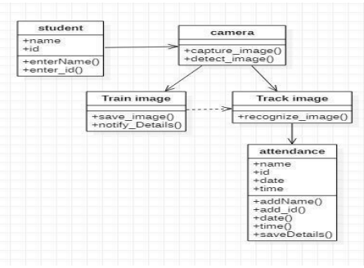
Class Diagram

Slide 9
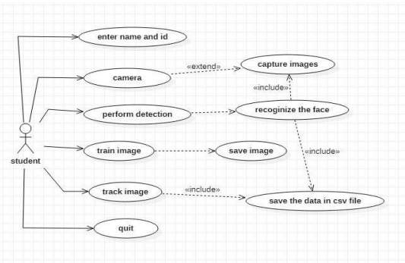
USE case Diagram

Slide 10
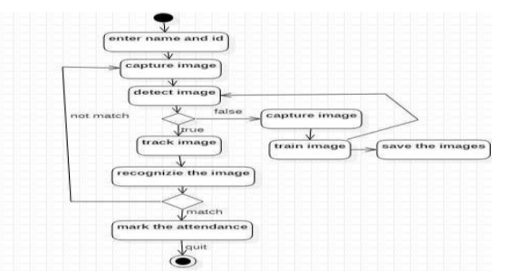
activity Diagram

Slide 11
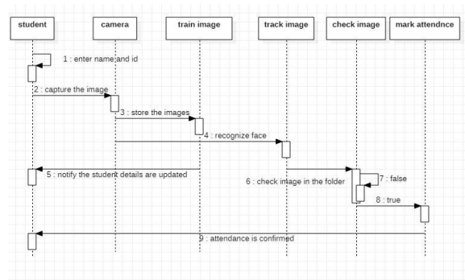
sequence Diagram

Slide 12
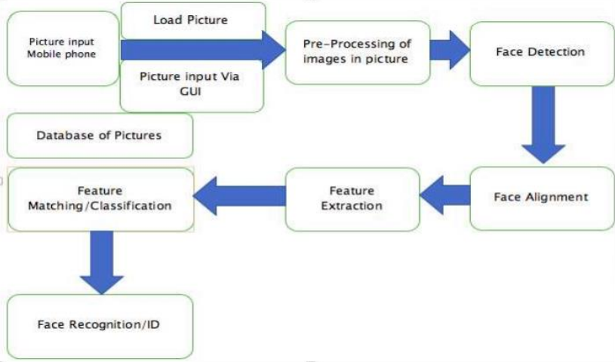
Working of application

Slide 13
Hardware and software requirement
Software Requirement
Language – Python
GUI Framework – PyQTpy
Database and File System – Azure Blob Storage (Un-structured) and csv file format.
Hardware Requirement
SSD – 256 GB Minimum OR
HDD – 512 GB Minimum
Cache – 2 MB Minimum
Operating System – Windows 7+, Linux any Flavour and Macintosh any version
Camera – 2 MP Minimum

Slide 14
Screen design

Slide 15
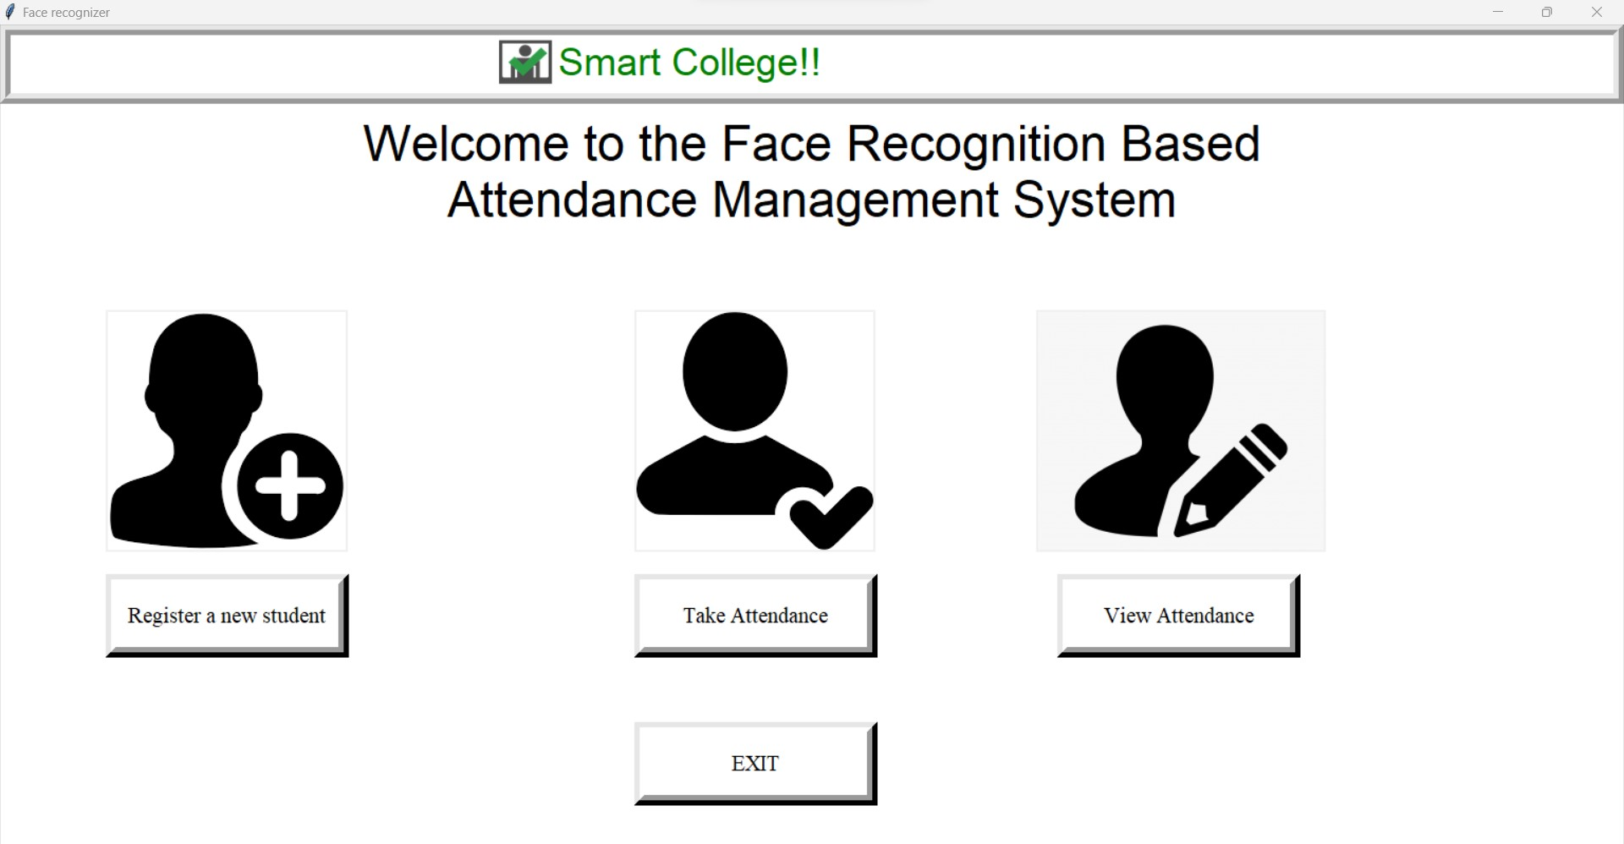

Slide 16
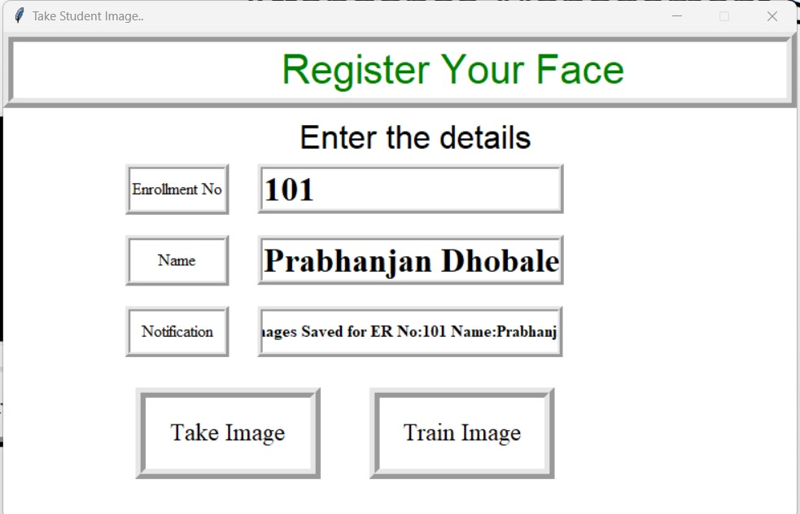

Slide 17
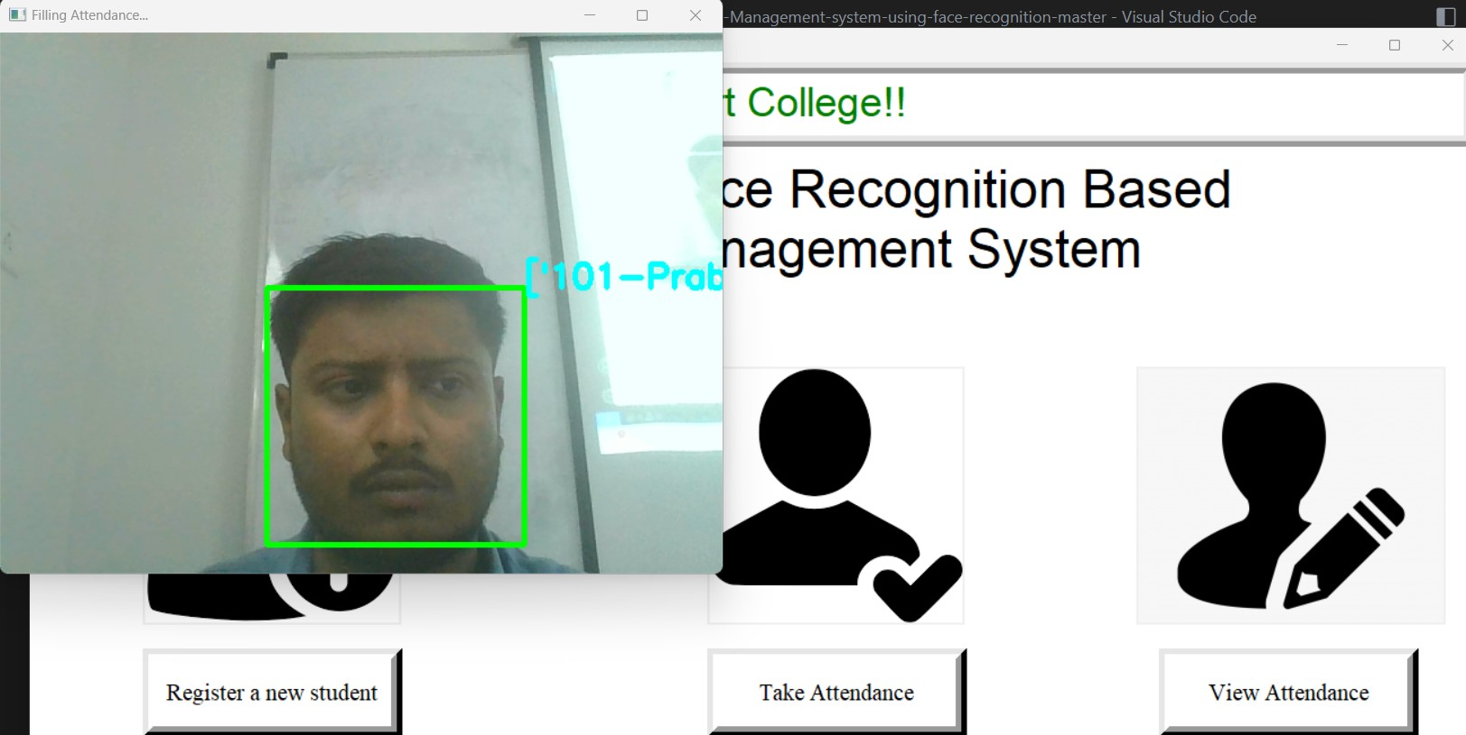

Slide 18
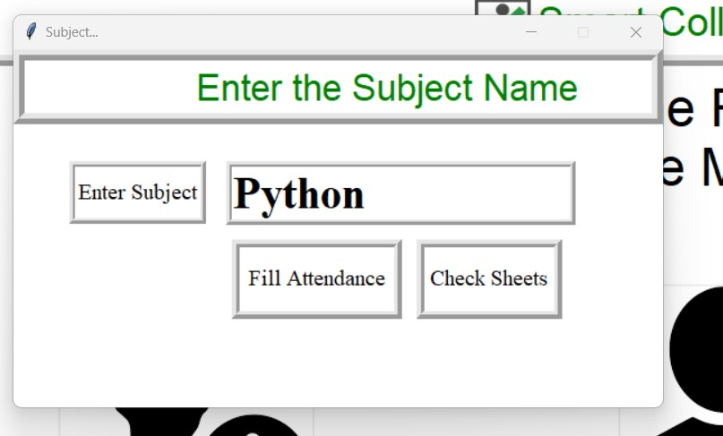

Slide 19
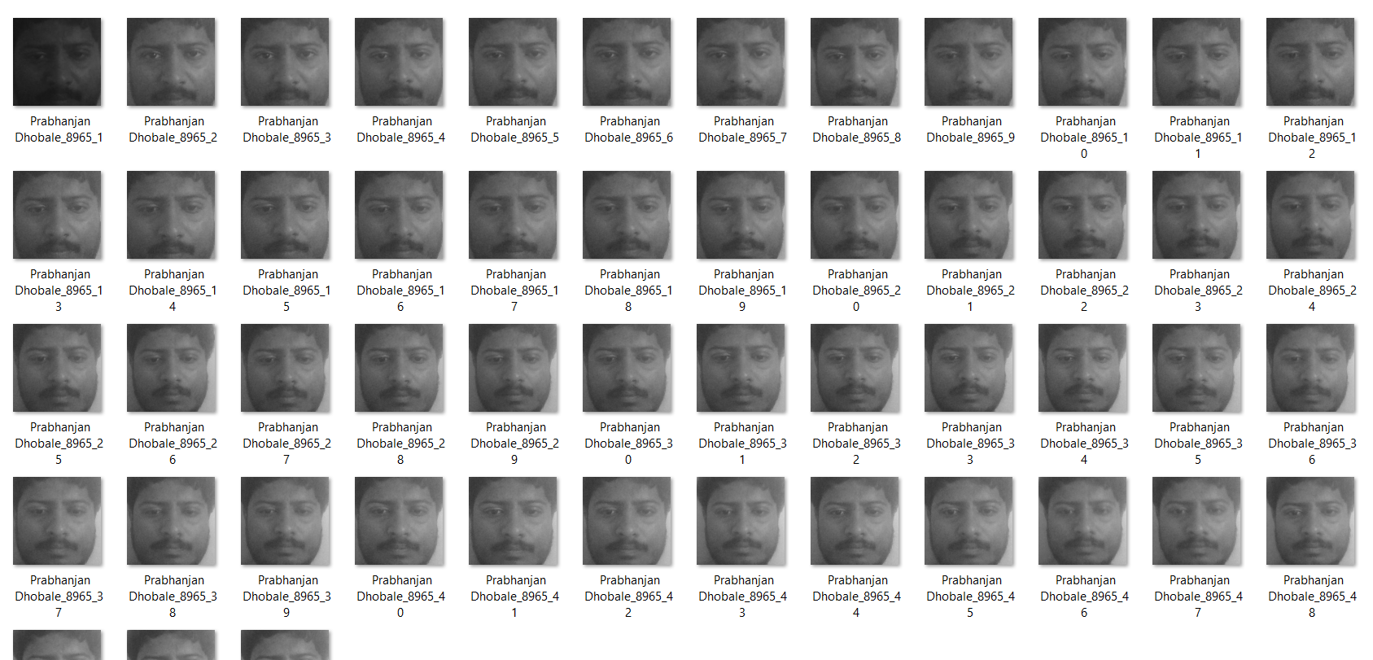

Slide 20
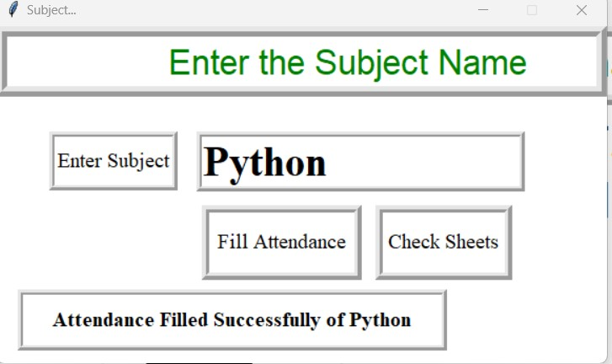

Slide 21
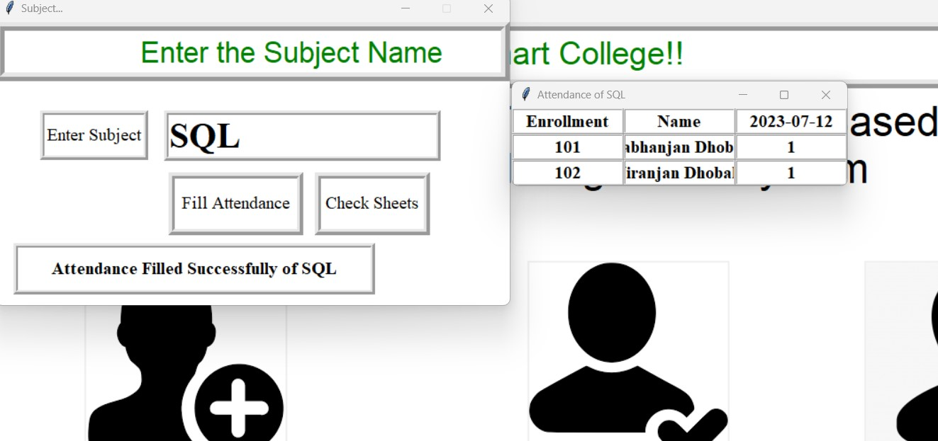

Slide 22
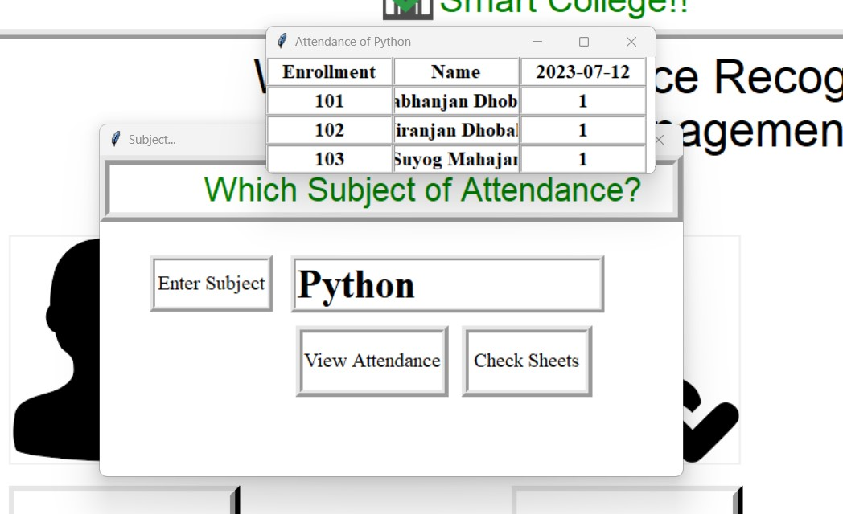

Slide 23
Test cases
Link : https://docs.google.com/spreadsheets/d/1BKs-_-n3XbaXvj1N--q2j_7rgaBM1UGWIKUbljfDhYA/edit?usp=sharing

Slide 24
USEr manual

Slide 25
Register a new student
Open Application and Select Register New Student.
Enter Details like Enrolment Number and Name.
Click on Take Image and wait until it capture image.
Once you hear message from system then click on Train Image.
New Student record will be created.

Slide 26
Take attendance
Open Application and Select Take Attendance
Enter Subject Name and Click on Fill Attendance
Your camera will be on and then it will click image
You can hear sound from system that attendance has been recorded
Now you can check your attendance using Check Status

Slide 27
view attendance
Open Application and Select View Attendance
Enter Subject Name and Click on View Attendance
Then you can see window where all records are shown

Slide 28
Thank you

